Slide 1
PUBLIC SECTOR

Slide 2
INTRODUCTION
public sector, portion of the economy composed of all levels of government and government-controlled enterprises. It does not include private companies, voluntary organizations, and households

Slide 3
CASE STUDIES
Strategic workforce planning supports organisations in getting the right people in the right job or position at the right time. It enables organisations to assess and prepare for current and future needs such as the size of the workforce, deployment of the workforce and the knowledge, skills and competences available and needed to achieve its mission and strategic objectives. A forward-looking public sector conducting business-linked workforce planning on a regular basis can proactively anticipate workforce needs instead of merely reacting to any crisis or other challenges. Throughout the COVID-19 crisis the need for strategic workforce planning became evident to be able to leverage a workforce in moments of crisis and deploy the workforce where and when needed.

Slide 4
CASE STUDIES
Building a maturity model to draw a clear path
As the principal guiding framework, the APSC team designed a maturity model which rates strategic workforce planning capability across four dimensions: business strategy, people and culture/implementation, reporting and data/workforce analytics and governance & tools, in four maturity levels (Table 5.1). In this way, the model looks beyond the work of workforce planners and analysis, taking into account the broader ecosystem that supports their work in agencies, including senior leadership capability and buy-in, business alignment and a culture of implementing workforce strategies and plans to drive business-aligned workforce transformation. Overall, the APS was categorised as reaching level two (of four) of maturity for business strategy, people and culture/implementation, and governance & tools. In the dimension of reporting and data/workforce analytics, the APS reached level one.

Slide 5
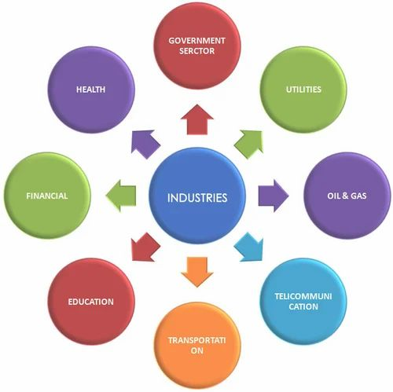


Slide 6
CONCLUSION
Dominant ideas about the role of public sector organizations in development have changed dramatically. In the 1950s and 1960s, the public sector was awarded undisputed primacy as the creator and implementor of strategies for development. Its technical, and simultaneously altruistic, élites would guide economies and societies along the path of modernization. In the 1970s, critical self-reflection combined with assault from radical development theory saw the image of an efficacious public sector severely challenged. Could it generate and maintain the impetus for development? By the 1980s, the answer to this question was clearly and widely articulated. The public sector was a pariah, which actually hindered economic and social development. The time had come to roll back the state by privatizing the public enterprises so vigorously promoted in an earlier era and downsizing the ministries which had been encouraged to expand into ever more areas of social and economic life.

Slide 7
TEAM MEMBERS :
AARTHI .B (927621BAD002)
HARI PRIYA .I (927621BAD013)

